Slide 1
MBA201
Module-1
Introduction to HRM: Introduction HRM: Introduction to Human Capital Management,
meaning, nature, scope of HRM, Definition of Human Capital,
Importance and Evolution of the concept of HRM,
Major functions of HRM,
Principles of HRM.
Difference between Personnel Management and HRM,
Changing role of HR in India, Recent trends in HR.

Slide 2
Learning Outcomes
Understand and gain practical experience in the field of Human Resource Concepts, functions and theories.
Acquire conceptual insight of Human Resource and various functions of HR.
Apply personnel, managerial and welfare aspects of HR.
Perceive greater understanding about HR practices.
Perceive knowledge about the future trends in HRM

Slide 3
Human capital management (HCM)
Human capital management (HCM) is the set of practices an organization uses for recruiting, managing, developing, and optimizing employees to increase their value to the company. Done right, human capital management results in: Hiring the right talent. Having all the necessary skill sets in the company's workforce.

Slide 4
HRM: Its Relevance
Human resource management operates on the
‘people’ dimension of an organization.
Its function comprises anchoring the systems’ processes and practices for acquiring, developing, and motivating people for performance and engaging them for achieving the objectives of the organization.
This is valid for all organizations irrespective of their nature: government, business, education, health, recreation, or social action.

Slide 5
HRM: Its Relevance
4. One of the reasons why HRM may appear
to be a nebulous and somewhat elusive concept is on account of multiple existing definitions of the term.
HRM is a stretchable term, covering a range of applications that have a wide variance across industries.
5. It involves forecasting the organization's future human resource needs and planning for how those needs will be met.

Slide 6

The planning, organizing, directing and controlling of the procurement, development, compensation, integration, and maintenance of human resource to the end those individual, organizational, and social objectives are accomplished. (Flippo, 1984).

Slide 7

HRM has been defined as “a strategic approach to managing employment relations which emphasizes that leveraging people’s capabilities is critical to achieving competitive advantage, this being achieved through a distinctive set of integrated employment policies, programmes and practices” (Bratton and Gold, Human Resource Management: Theory and Practice. 2007. Macmillan Press).

Slide 8

It is the art of procuring, developing, and maintaining competent, workforce to achieve the goals of an organization in an effective and efficient manner.
Pervasive force
Action oriented
Individually oriented
People oriented
Future oriented

Slide 9

Development oriented
Integrating mechanism
Comprehensive function
Auxiliary service
Interdisciplinary function
Continuous function

Slide 10

At the Enterprise level:
1. Good HR practices-Attracting and retaining best people, Planning – Short, medium & long run
2. Training- challenges, attitudes, team spirit, developing loyalty and commitment through appropriate reward schemes
At the Individual level:
1. Team work and team spirit
2. Growth opportunities to potential
3. People to work with diligence and commitment

Slide 11
At the Society level:
1. Employment opportunities multiply
2. Scarce talents are put to best use
At the National level
1. Natural, Physical, and Financial resources put to best use

Slide 12

Comprehensiveness
Credibility
Communication
Control
Change
Commitment
Cost effectiveness
Competence
Creativity
Coherence

Slide 13

Personnel aspect:
Welfare aspect:
Industrial Relations aspect:

Slide 14










The scope of HRM covers but is not limited to the following functions:
Training and Development
Industrial Relations
Hiring (Recruitment and Selection)
Grievance Handling
HR planning
Payroll Management
Rewards and Recognitions
Legal Procedures
Therefore, HRM is about developing and managing harmonious relationships at workplace and striking a balance between organizational goals and individual goals.

Slide 15



The scope of HRM is extensive and far-reaching. Therefore, it is very difficult to define it concisely. However, we can classify the scope of HRM under the following three categories:
HRM in
Personnel Management
HRM in
Employee Welfare
HRM in
Industrial Relations
Let’s look at each in detail.

Slide 16


HRM in Personnel Management:
HRM in Personnel Management is typically direct manpower management that involves manpower planning, hiring (recruitment and selection), training and development, induction and orientation, transfer, promotion, employee productivity, compensation, layoff and retrenchment.

Slide 17

HRM in Employee Welfare:
This particular aspect of HRM deals with working conditions and amenities at workplace. This includes a wide array of responsibilities and services such as safety services, health services, welfare funds, social security and medical services. It also covers appointment of safety officers, making the environment worth working, eliminating workplace hazards, support by top management, job safety, safeguarding machinery, cleanliness, proper ventilation and lighting, sanitation, medical care, sickness benefits, employment injury benefits, personal injury benefits, maternity benefits, unemployment benefits and family benefits. it also takes care of canteen facilities, crèches, rest and lunch rooms, housing, transport, medical assistance, education, health and safety, recreation facilities, etc..

Slide 18

HRM in Industrial Relations: Since it is a highly sensitive area, it needs careful interactions with labor or employee unions, addressing their grievances and settling the disputes effectively in order to maintain peace and harmony in the organization. It is the art and science of understanding the employment (union-management) relations, joint consultation, disciplinary procedures, solving problems with mutual efforts, understanding human behavior and maintaining work relations, collective bargaining and settlement of disputes.

Slide 19

Planning: Plan and research about wage trends,
labor market conditions, union demands and other personnel benefits. Forecasting manpower needs etc.
Organizing: Organizing manpower and material resources by creating authorities and responsibilities for the achievement of organizational goals and objectives.
Staffing: Recruitment & Selection
Directing: Issuance of orders and instructions, providing guidance and motivation of employees to follow the path laid-down.
Controlling: Regulating personnel activities and policies according to plans. Observations and comparisons of deviations

Slide 20
Procurement: Planning, Recruitment and Selection, Induction and Placement
Development: Training, Development, Career planning and counseling.
Compensation: Wage and Salary determination and administration
Integration: Integration of human resources with organization.
Maintenance: Sustaining and improving working conditions, retentions, employee communication
Separations: Managing separations caused by resignations, terminations, lay offs, death, medical sickness etc.

Slide 21
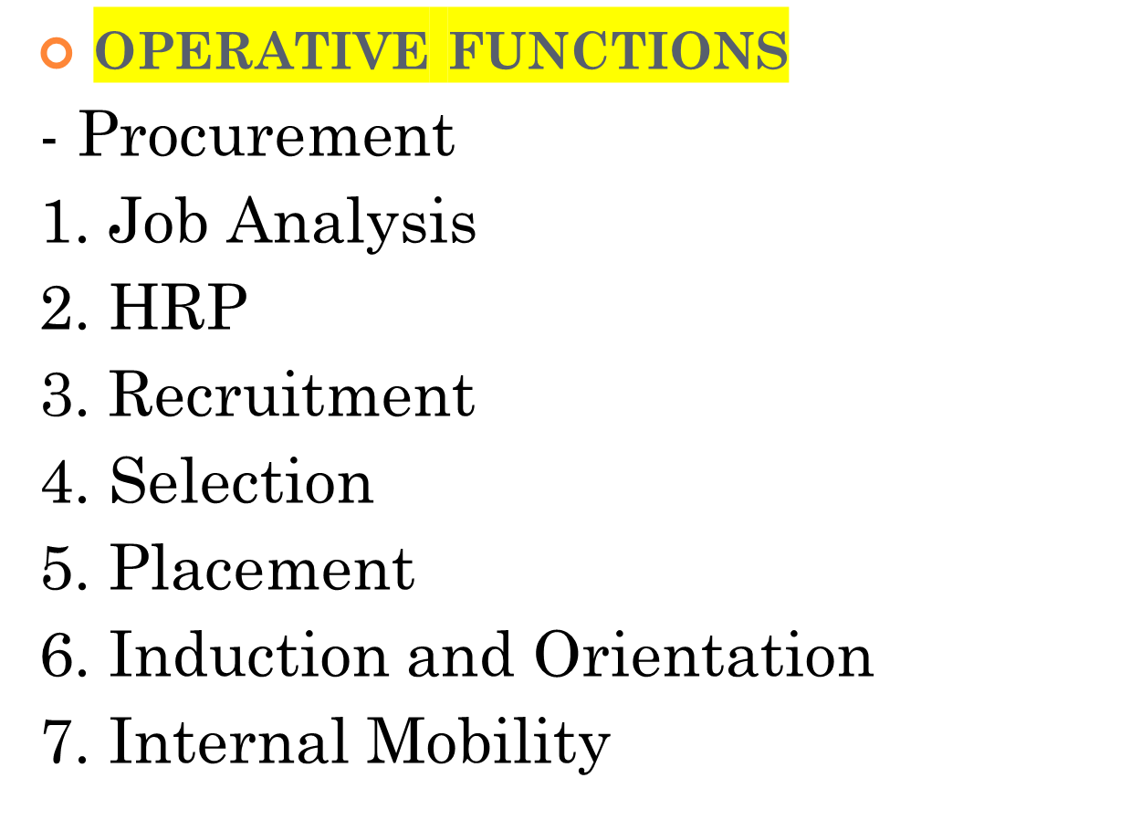

Slide 22


Slide 23

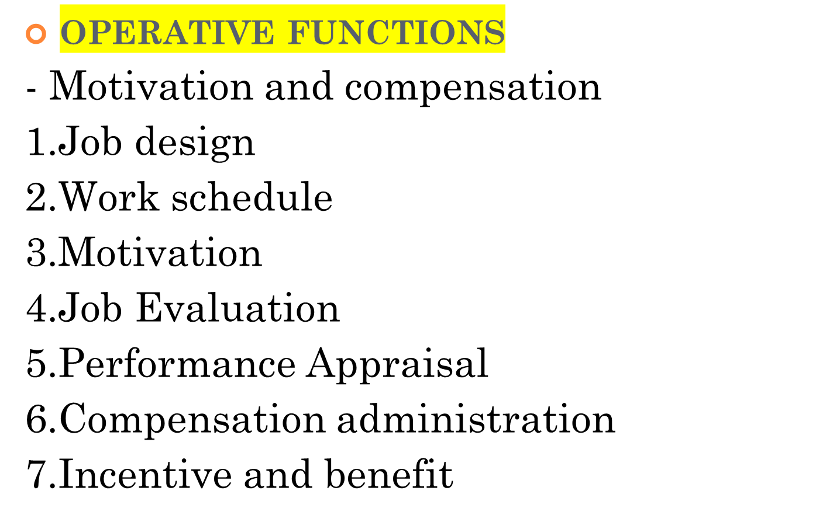

Slide 24


Slide 25


Slide 26


Slide 27
HRM Objectives | Supporting HRM Functions
Social Objectives (3) | Legal Compliance Benefits Union Management Relations
Organizational Objectives (7) | Human Resource Planning Employee Relations Recruitment & Selection Training & Development Performance Appraisals Placement & Orientation Employee Assessment
Functional Objectives (3) | Performance Appraisals Placement & Orientation Employee Assessment
Personal Objectives (5) | Training & Development Performance Appraisals Placement & Orientation Compensation Employee Assessment

Slide 28
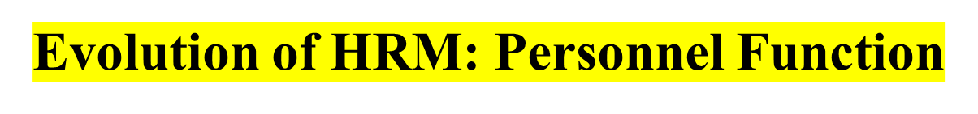
The Commodity Concept
The Factor of Production Concept
The Goodwill Concept
The Paternalistic Concept
The Humanitarian Concept
The Human Resource Concept
The Emerging Concept

Slide 29


The Industrial revolution
The Scientific management
The Trade Unionism
The Human Relations movement
The Human Resources approach

Slide 30

EARLY PHASE
LEGAL PHASE
WELFARE PHASE
DEVELOPMENT PHASE

Slide 31
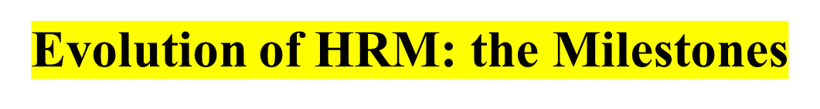
1796⎯The first authenticated strike in America happens.
1881⎯Frederick Taylor starts working in scientific management at the Midvale Steel Plant.
1924⎯ Point method of job evaluation was developed.
1927⎯Hawthorne studies begun by Mayo, Roethlisberger, and Dickson.
1976⎯Human Resource Certification Institute begins certification.
1985⎯Focus on employee participation in management to improve productivity and competitive position.
1991⎯Focus on global HR practices; greater use of temporary employees.
1995⎯Emphasis on greater diversity in the workforce and on total quality management; downsizing or ‘rightsizing’ of organizations.
1990s⎯Use of competency models to guide HR program design.

Slide 32

Globalization⎯competitiveness, pressure on quality and cost. Dilemma of replication of best practices, while preserving the good local culture.
Technology⎯the impact of digitalization and access to the Internet on all HR processes.
Demographic changes in the workforce⎯ challenges of diversity, aging workforce in the west, millenials in the east.

Slide 33

PM and HRM are the successive stages of the same concept without any difference in the concept.
In his words, “ Human Resource Management is just the continuing process of personnel management – it is not different. ”

Slide 34
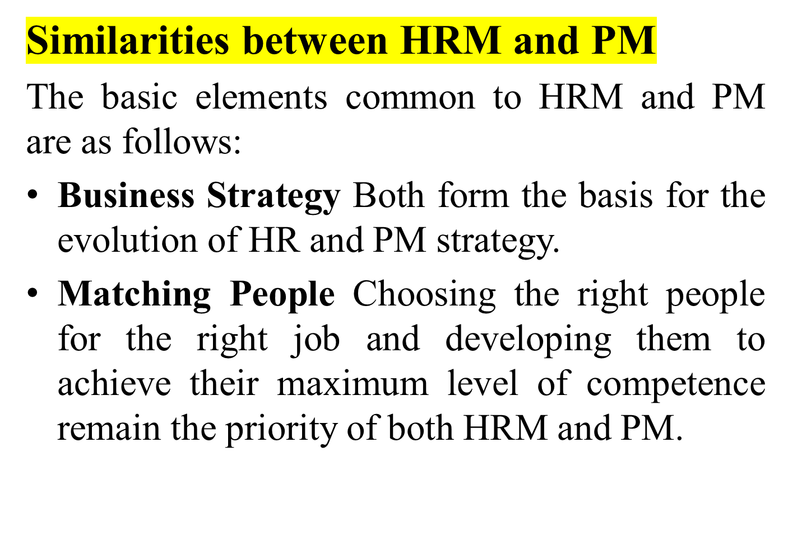

Slide 35
Prominence of Line Authority HRM, similar to PM, recognizes that the primary responsibility for managing people stays with line managers.
Identical Core Elements Techniques like selection, training, development, compensation and performance management are common to both HRM and PM.

Slide 36
Emphasis on Communication and Participation HRM and PM provide equal importance to the communication process and workers’ participation in decision making.
We shall now discuss the differences between these two concepts.

Slide 37
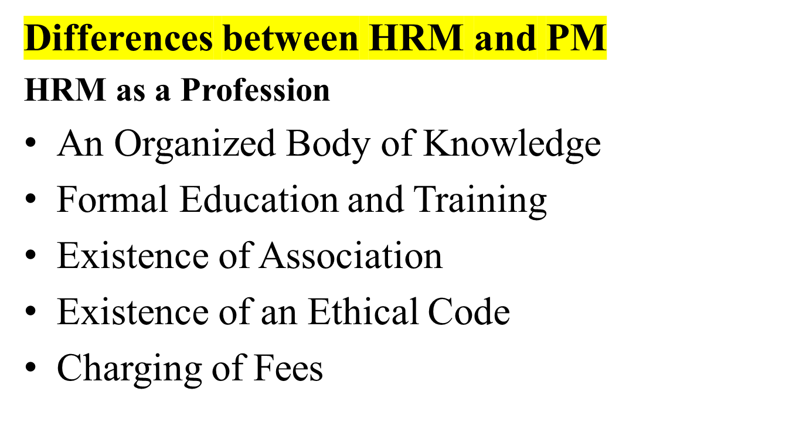

Slide 38
HRM | PM
HRM is proactive in nature. It is not only concerned with the present organizational conditions but foresees future necessities and then acts appropriately. | PM is mainly reactive in nature. It satisfies itself by ensuring peaceful labour–management relations in the present.
HRM, as a resource-centred activity, focuses more on the managerial aspects, in terms of delegating the responsibility of HRM to line authority and management development | PM, which is basically employee-centred, aims at hiring, training, compensating and maintaining the existing workforce of the organization.
HRM emphasizes open-ended contracts, which can be modified depending upon the demands of the business. Management assumes the responsibility to motivate the employees and constantly inspires performance based on team spirit. | HRM emphasizes open-ended contracts, which can be modified depending upon the demands of the business. Management assumes the responsibility to motivate the employees and constantly inspires performance based on team spirit.

Slide 39
HRM | PM
HRM is based on the principle that better performance itself is a cause of job satisfaction and morale. | PM considers job satisfaction and morale as a source of better performance. It works on the foundation that a contented worker is a productive worker.
HRM seeks to develop the competencies of the employees on a sustained basis. Skill formation and development are recognized as the main characteristics of HRM. | PM is a regular, status quo-based administrative function: Employees get uniform rewards based on job evaluation and job worth.
HRM emphasizes autonomous work groups, challenging jobs, and creativity for motivating the people. The management assumes the responsibility to motivate the employees and continuously encourage the performance based on unity of goals. | PM emphasizes monetary rewards and conventional job designs like job simplification and rotation to encourage people to improve their performance.

Slide 40

Controversies about the linkage between HRM and firm performance/service quality.
Research on:
  HRM and firm performance,
  HRM and service quality, and
  HRM and total quality management.
Deloitte’s report on taking HR to the next level through strategy creation and alignment.

Slide 41

Personal credibility: models the values of the organization, builds a trust-based relationship, and demonstrates a conviction, based on evidence, about how business can win.
Change management: leads change, able to diagnose problems, build client relations, articulate a vision, set a leadership agenda.
Manage culture: custodian of the culture, creates culture congruent with the strategy and vision, enrols employees, describes behavior specific to the culture.
Delivers human resource practices: expert in the state-of-the-art innovative HR practices.
Business knowledge: understands strategy, market, competitors, finance, IT, and so on.

Slide 42

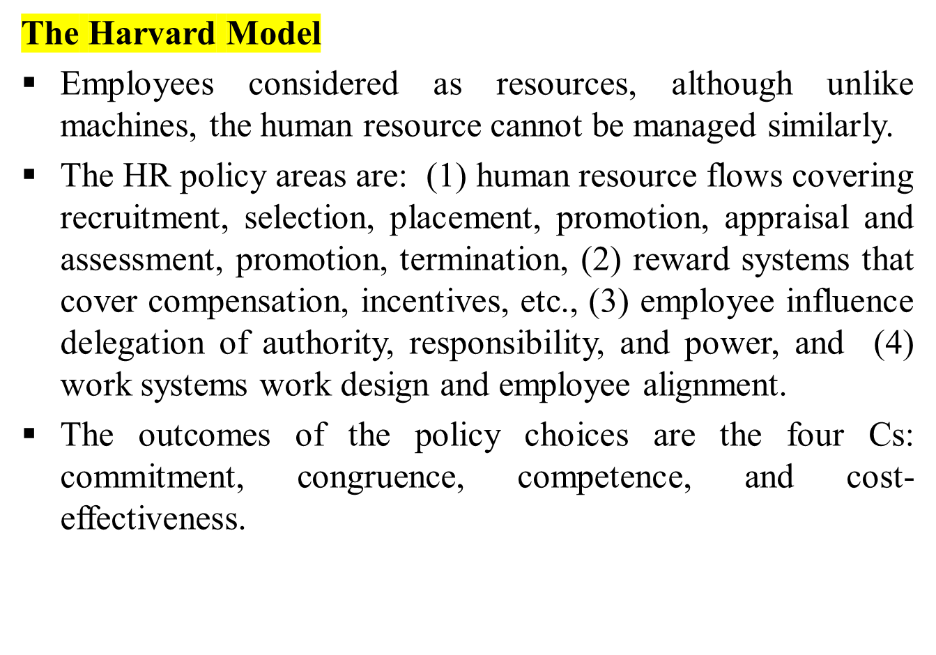

Slide 43

The hard approach about resources and does not differentiate human resources from other resources.
People should be acquired cheap and be managed for the maximum yield, and to be used efficiently and developed to have better values.
Human resource strategies should aim at matching the business strategies.
The HR role is nonstrategic. The role of environmental factors in shaping human resource management is largely underplayed.
There are only four common HR processes: selection—matching people to jobs; appraisal of performance; rewards—emphasizing the real importance of pay and other forms of compensation in achieving results; and development of skilled individuals.

Slide 44
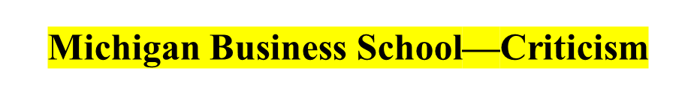
Contrary to its presumption, decisions are not always made following a rational and mechanical path.
Strategy making is similarly a complicated process, tending to get decided sometimes in a personalized manner, intuitively, even politically.
It is prescriptive and normative with a clear suggestion that the compatibility to the business strategy should decide the HR strategy.

Slide 45
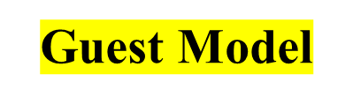
David Guest’s model of HRM flows in six sequential elements building up to a variety of outcomes:
HRM strategy
HRM practices (hiring , training , appraisal, compensation, relations)
HRM outcomes (commitment, quality , flexibility)
Behavior outcomes (motivation, cooperation, organizational citizenship)
Performance outcomes (positive productivity, innovation, quality; negative low productivity, absenteeism, turnover)
Financial outcomes (profit, ROI)
The model has been criticized as prescriptive and idealistic in its basic assumptions. It links intangible factors such as flexibility and motivation with profit and ROI in a causal relationship. Guest, nonetheless, admitted to the uncertain relationship between commitment and performance outcomes.

Slide 46
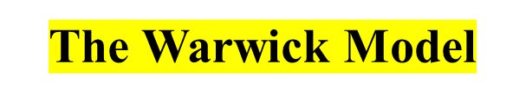
This model introduced an outer context (socio-economic, technical, politico-legal, and competitive) and an inner context (culture, structure, politics/leadership, task technology, and business output).
Contexts interact to lead to HRM contents (HR flows, work systems, reward systems, and employee relations). The Warwick model thus emphasized the influence of both external and internal dynamics to shape HRM and, in this way, it is an improvement on the Guest model.

Slide 47

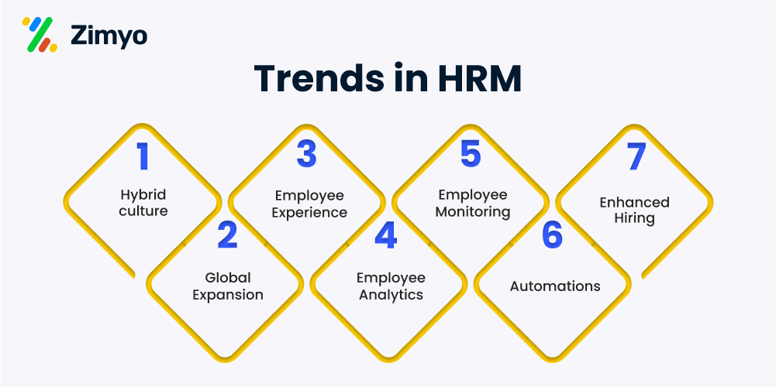

Slide 48
Thank you!

